Slide 1
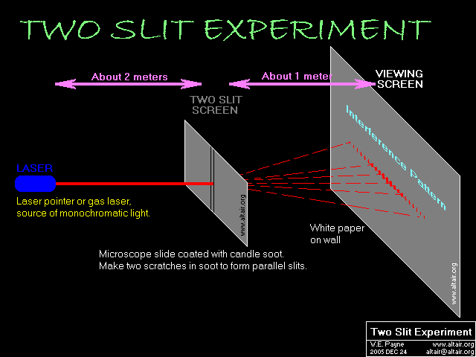
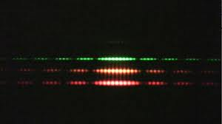
Section 17: Interference

Slide 2
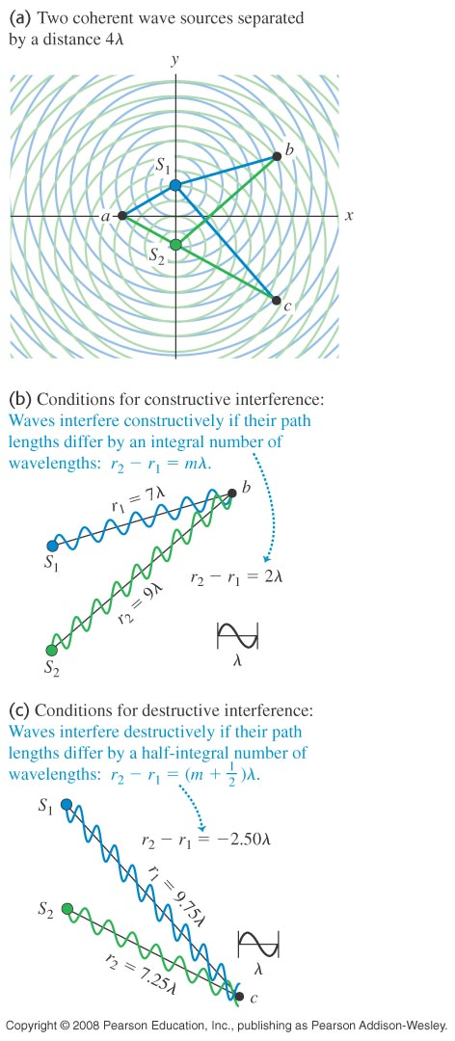
Two Source Interference: A “snapshot”

Slide 3
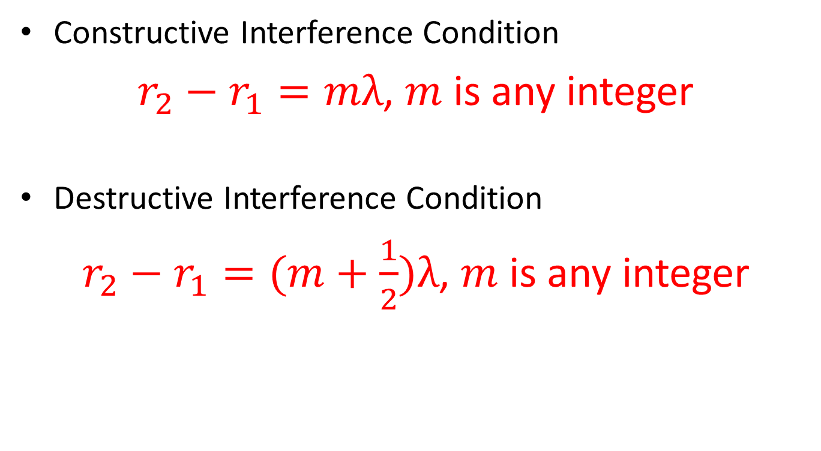
Two Source Interference
Constructive Interference Condition
$r_{2}−r_{1}=mλ$, $m$ is any integer
Destructive Interference Condition
$r_{2}−r_{1}=(m+\frac{1}{2})λ$, $m$ is any integer

Slide 4
Two-source Interference
Hewitt: 20.18

Slide 5
Activity: Radio Transmitters I

Slide 6
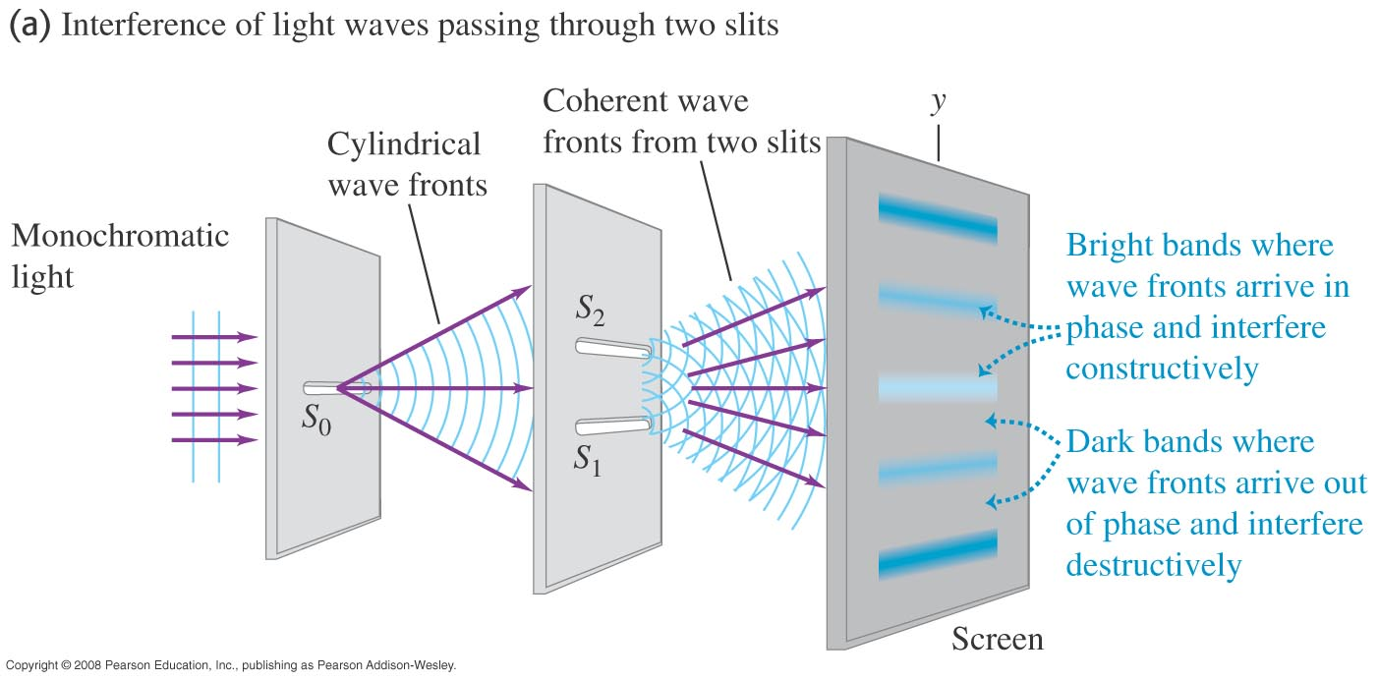
Two-Slit Interference

Slide 7
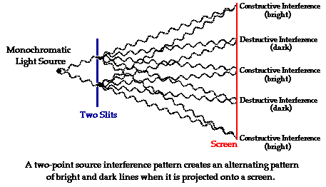
Two-slit interference pattern

Slide 8
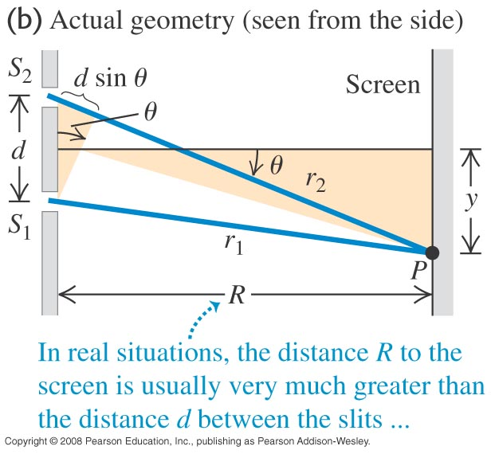
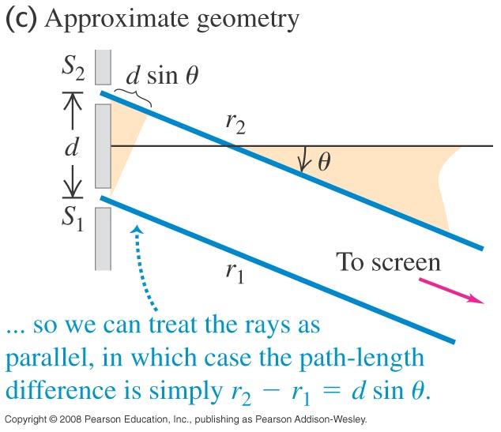
The far-field approximation

Slide 9

Far-field Approximation
The path length difference can be approximated by
$$∆r≈d\sin{θ}$$

Slide 10

Interference Conditions: Far-Field Approximation
$d\sin{θ}≈mλ$ Constructive Interference
$d\sin{θ}≈\left(m+\frac{1}{2}\right)λ$ Destructive Interference

Slide 11
Radio Transmitters II

Slide 12
The Effect of Different Wavelengths

Slide 13
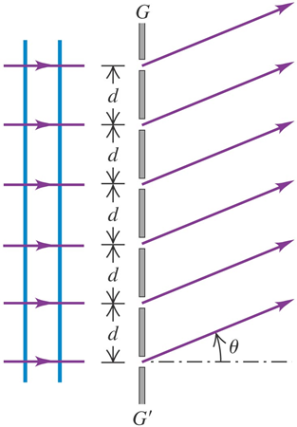
A Diffraction Grating – Multiple Slits

Slide 14

Diffraction Grating
Constructive Interference: Same Condition
$$d\sin{θ}=mλ$$

Slide 15
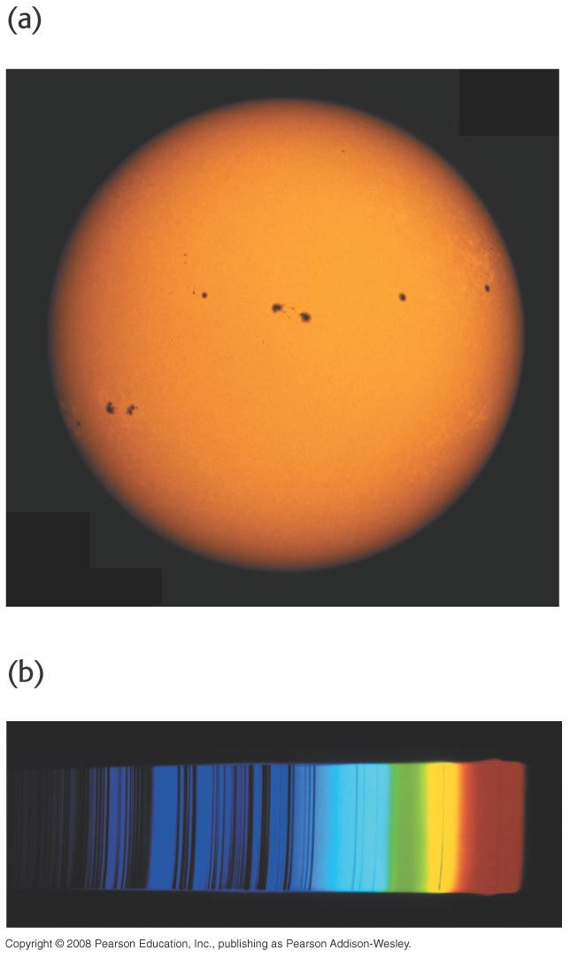
Uses of a Diffraction Grating

Slide 16
Demo: Diffraction Grating

Slide 17
Two-Slit Interference Lab

